Slide 1
Viola Desmond’s Canada: Confronting Racism in the Promised Land
Graham Reynolds
Professor Emeritus and
Viola Desmond Chair in Social Justice
Cape Breton University
2016 Human Rights and Labour Law
Conference, Halifax

Slide 2
Viola Desmond’s Canada: A History of Blacks and Racial Segregation in the Promised Land Graham Reynolds With Wanda Robson and Forward by George Elliot Clarke

Slide 3
Viola Desmond’s Canada: A History of Blacks and Racial Segregation in the Promised Land
The book is written for the general reader as well as all students of Canadian history.
It provides readers with a concise narrative of the Black experience in Canada from slavery under French and British rule in the late seventeenth century to the struggle for racial equality in the twentieth century

Slide 4
What need is there for this book?
The majority of Canadians have very little understanding of the Black experience in Canada and the central role race has played in Canadian history.

Slide 5
What is new in Viola Desmond’s Canada?
The book is the first comprehensive and authoritative account of the Viola Desmond story as told, in part, by Wanda Robson, Viola’s youngest sister.
Viola Desmond’s Canada also includes new historical insights and documents never before published.

Slide 6
Viola Desmond Canada’s Rosa Parks

Slide 7
How many Canadians know the Viola Desmond story?
In 1946, Viola Desmond stood up against the practice of racial segregation in Nova Scotia by refusing to give up her seat in a whites-only section of a theater in New Glasgow. She was forcefully removed from the theatre and arrested.
After spending the night in jail she was brought before a local magistrate and found guilty of defrauding the province of one cent in amusement tax.
That was the difference in tax between the the ticket she was given for the Black section and the ticket for the whites-only section of the theatre.

Slide 8
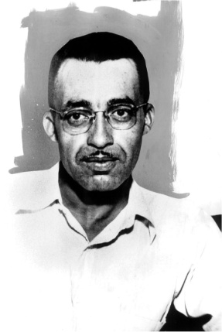
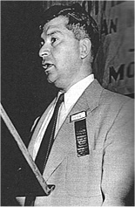
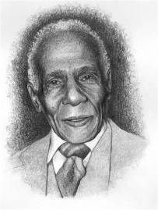
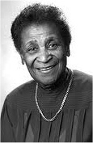
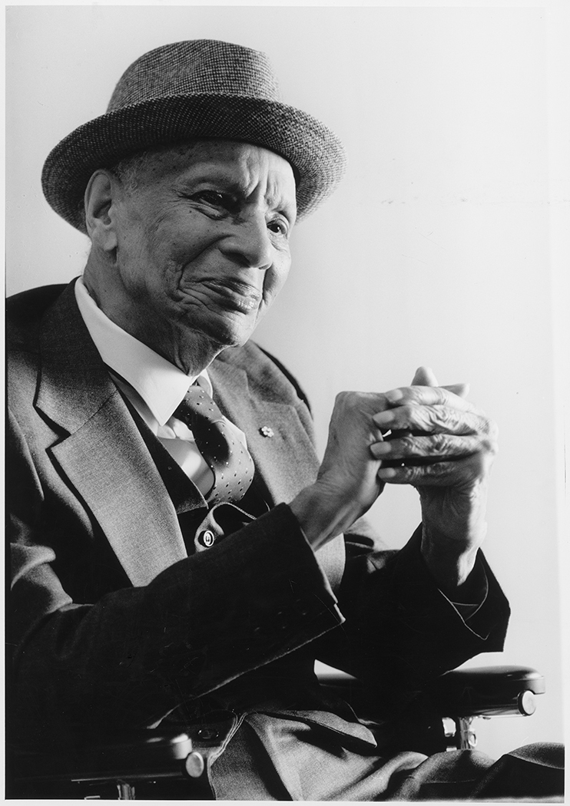
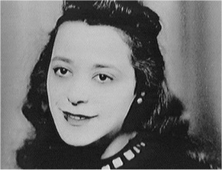
Viola Desmond is a symbol of a forgotten generation of Canadian civil rights activists
Kalmen Kaplansky
Pearleen Oliver
Stanley Grizzle
Carrie Best
C
Hugh Burnett
Stanley Grizzle
Carrie M Best
Viola Desmond
Donald Moore

Slide 9
A culture of racism existed in Canada during most of the twentieth century
An uneven pattern of racial segregation existed in most regions of the country.
Blacks were excluded from hotels and restaurants while many theatres, schools and neighborhoods were segregated.
Even Black veterans of WW II were refused service and denied even a cup of coffee in many restaurants and cafes in Ontario and Nova Scotia.

Slide 10
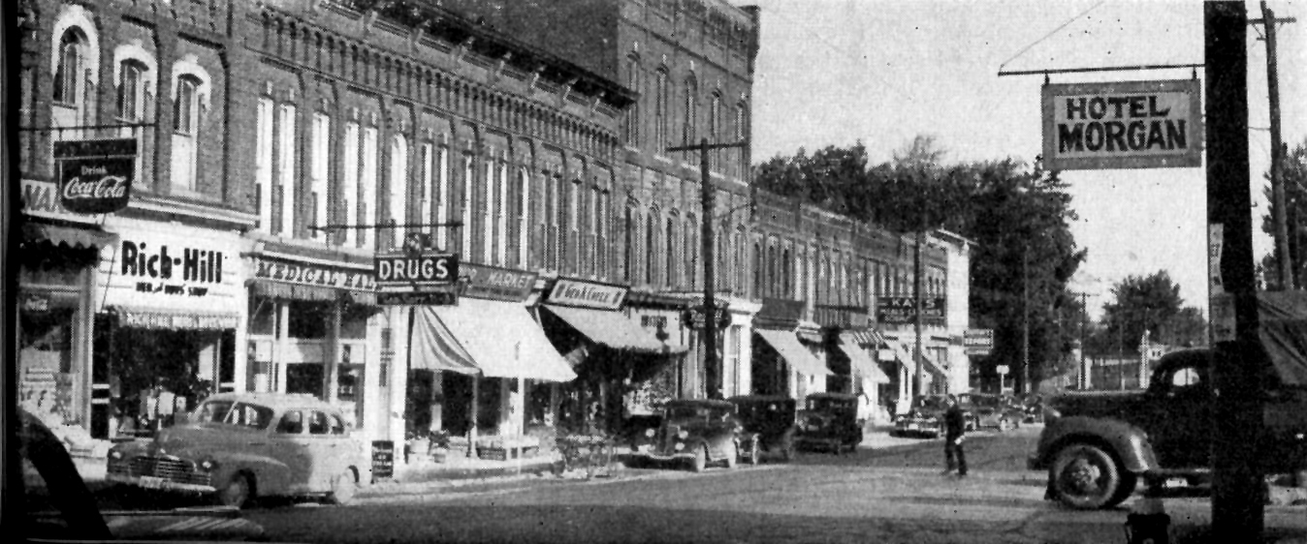
Dresden, Ontario 1949

Slide 11
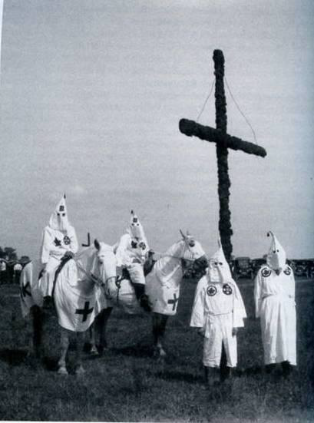
Historically, the culture of racism in Canada followed a similar pattern to that of the United States. Racial segregation in Canada mimicked the practice of Jim Crow in the American south.

Slide 12
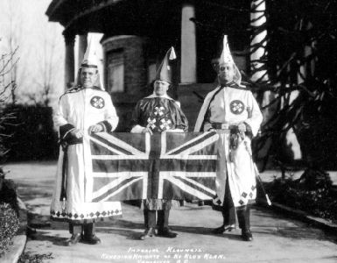
During the 1920s, the Ku Klux Klan was an active mainstream organization in most provinces. Mass hooded gatherings and cross-burning occurred in many regions of the country

Slide 13
The current face of racism in Canada
Most Canadians find it difficult to accept that racism is still a problem in Canada today.
Acknowledging the existence of racism has proven difficult because it conflicts with our national self-image as a liberal democratic society grounded on the values of diversity, fairness and equality
It is also, perhaps, all to easy for us to become distracted from putting our own house in order when so much attention is being drawn to the problems our neighbor to the south is having.

Slide 14
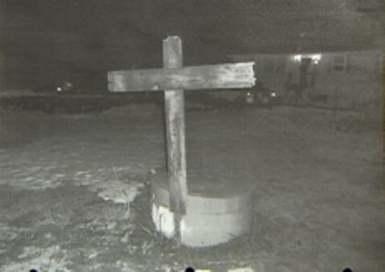
In 2010 a cross burning incident occurred in Hants county, Nova Scotia.
In 2012, a Black employee at Leon’s Furniture store in Dartmouth found a black statue with a hangman’s noose around its neck on his desk.
In March 2016, a Black teacher on the South Shore in Nova Scotia found a hangman’s noose on her door.

Slide 15
What all Canadians should know:
Although most overt forms of racial segregation ended by the 1960s, the culture of racism still exists in Canada today.
Racism in our society is never very far below the surface. Racial violence sometime erupts in our schools, sporting events and in other public places
Blacks are 3-5 times more likely to be carded in Toronto.
Blacks on average earn less than .80 cents on every dollar a white worker makes.

Slide 16
Former lieutenant–governor Mayann Francis says she faces racial profiling by store employees in Nova Scotia at least once a month. CBC news/Nova Scotia, March 30, 2016

Slide 17
“Shopping while Black”
Mayann Francis’ comments were in response to the recent court ruling that found a Sobey’s grocery store had discriminated against a Black customer when one of its employees falsely accused the customer of being a repeat shoplifter.

Slide 18
According to a recent study by the Nova Scotia Human Rights Commission, nearly 70% of Black Nova Scotians have experienced some form of consumer racial profiling.

Slide 19
Consumer racial profiling
The Nova Scotia Human Rights report confirmed that this form of racial discrimination was common among the service and retail industries, including:
Grocery, clothing and home improvement stores, as well as, restaurants, hotels and gas stations.
The report also documented incidents of consumer racial profiling involving a wide spectrum of discretionary practices ranging from being ignored or given slow service to more blatant acts such as following targeted customers, refusing to serve them, questioning their ability to pay for items in the store, verbal abuse, or, wrongful detention, search and arrest.

Slide 20
Anti-Black racism is a problem in the workplace

Slide 21
For Blacks today, racism is often a debilitating and degrading daily experience
Several recent studies in Ontario have documented the extent of anti-Black racism in the workplace.
A study published in 2015 by the Ontario Alliance of Black School Educators characterized racial discrimination in the workplace as a recurring, routine and everyday experience.

Slide 22
Racism is systemic and personal
Systemic or institutional racism relates to discriminatory policies, practices, and procedures.
Racism on the personal level involves biases, prejudices, and stereotypes that are held by individuals and often expressed in daily face-to-face interactions.

Slide 23
Racial Stereotypes
Racial stereotypes have a subtle and profound effect on the daily lives of individuals.
Black males, for example, are frequently victims of stereotypes that portray them as being less intelligent than whites, dishonest, lazy, aggressive, physically threatening and not worthy of being treated as equals.

Slide 24
A common response to racial stereotypes:
A Black male teacher disclosed in the Ontario Alliance of Black School Educators’ study that his strategy for dealing with racial stereotypes was to consciously present himself in such a way that these stereotypes could not be used against him.
At work, he was overdressed and overly formal in his interactions with others and was always careful not to be boisterous or to call attention to himself.
For this Black educator and many other Blacks in Canada’s labor market, dealing with racial stereotypes involves a constant vigil in which they can never really relax and be themselves.

Slide 25
What can we do?
Overcoming racism requires admitting that the problem exists and we are willing to engage in a open and honest dialogue about the reality of race and race relations in Canada.
Thank You

Slide 26
References:
Francis Henry and Carol Tator, The Colour of Democracy: Racism in Canadian Society (Toronto: Thomson and Nelson, 2006).
Ontario Alliance of Black Educators, Voices of Ontario Black Educators (Toronto: Turner Consulting group, 2015).
Graham Reynolds, Viola Desmond’s Canada: A History of Blacks and Racial Segregation in the Promised Land, (Winnipeg: Fernwood Publishing, 2016).
Nova Scotia Human Rights Commission, Working Together to Better Serve All Nova Scotians: A Report on Consumer Racial Profiling in Nova Scotia (Halifax: Government of Nova Scotia Publication, 2013)

